Slide 1

STRATEGY FORMULATION
Lecture Hours:50
Department of Management Studies
Visvesvaraya Technological University Belagavi-590018
umesh.bhushi@vtu.ac.in
Module#4
SUBJECT : MBA 205- CORPORATE STRATEGY
Faculty of Management Studies
VTU, Belagavi

Slide 2

COURSE OUTLINE
Lecture | Lecture Name | Lecture Hours
#1 | Module-1 Overview of strategic management | 7
#2 | Module-2 ASSESSING EXTERNAL ENVIRONMENT | 9
#3 | Module-3 ASSESSING INTERNAL ENVIRONMENT | 9
#4 | Module-4 STRATEGY FORMULATION | 9
#5 | Module-5 STRATEGY IMPLEMENTATION | 9
#6 | Module-6 STRATEGY EVALUATION | 7
 | Total Hours | 50

Slide 3
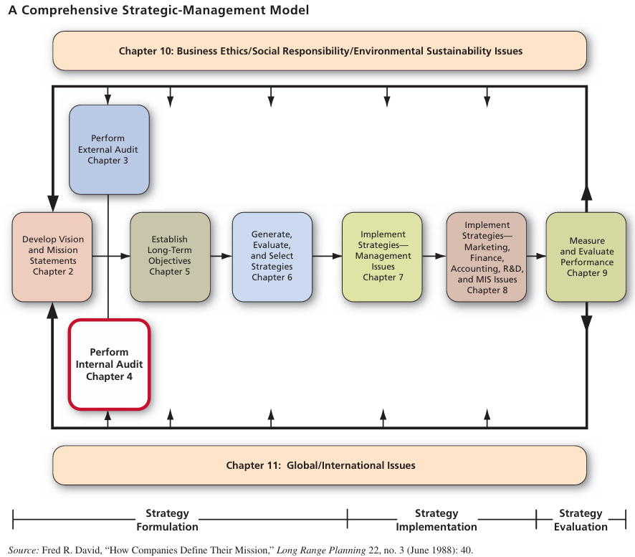

Slide 4
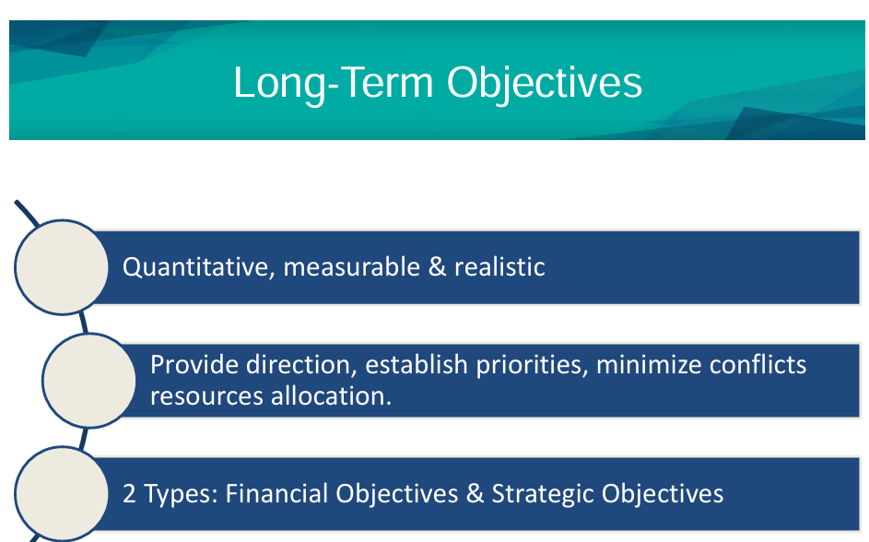

Slide 5
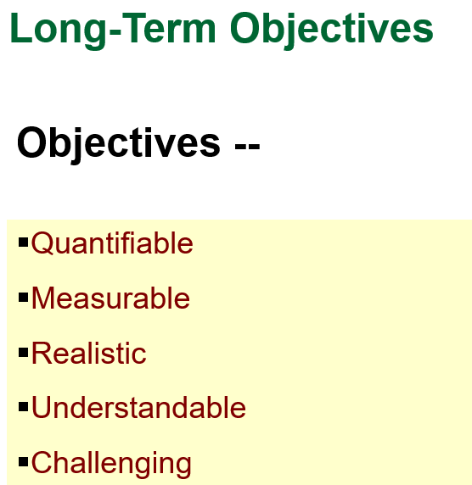
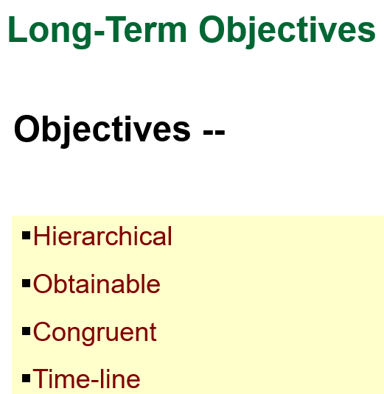

Slide 6
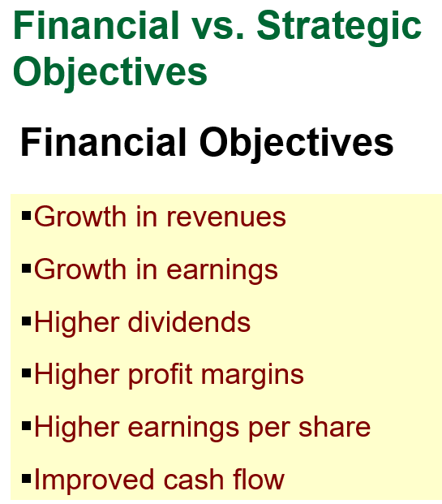

Slide 7
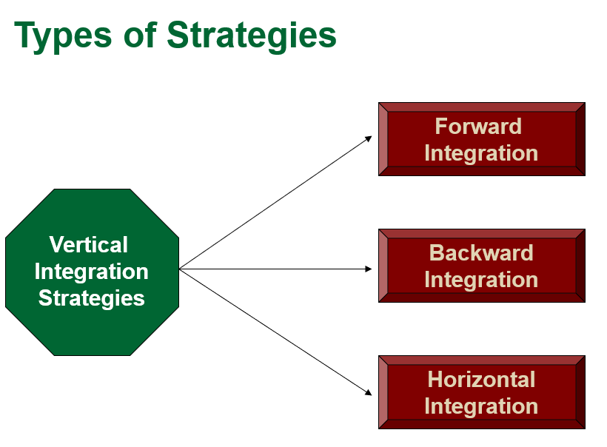
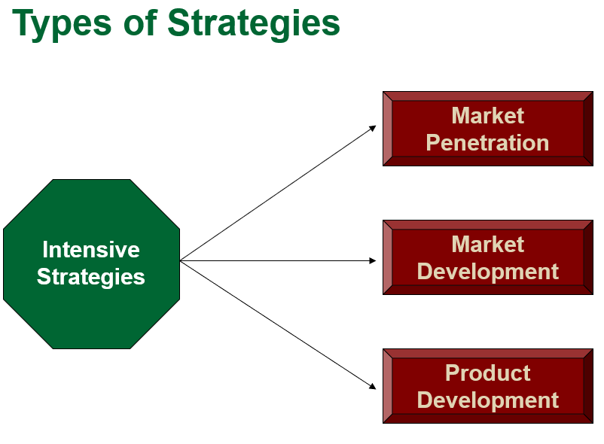
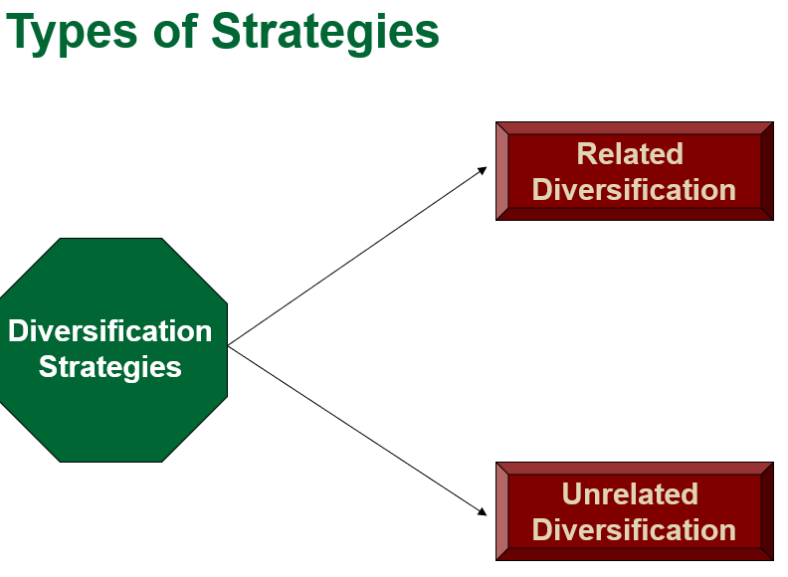
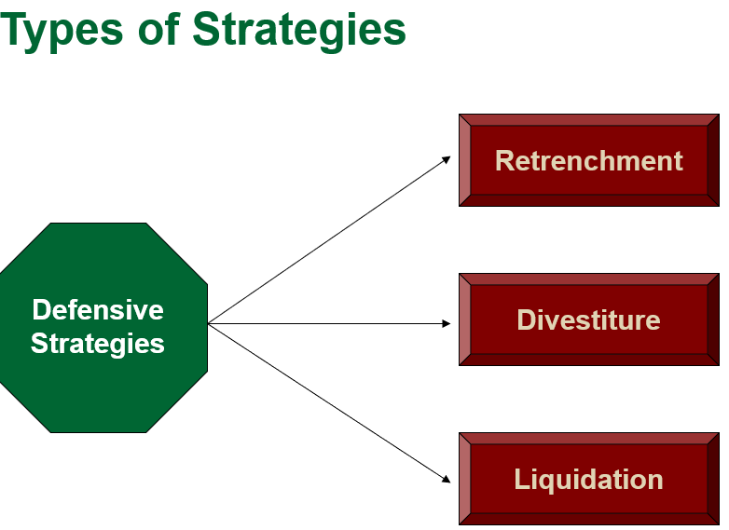

Slide 8
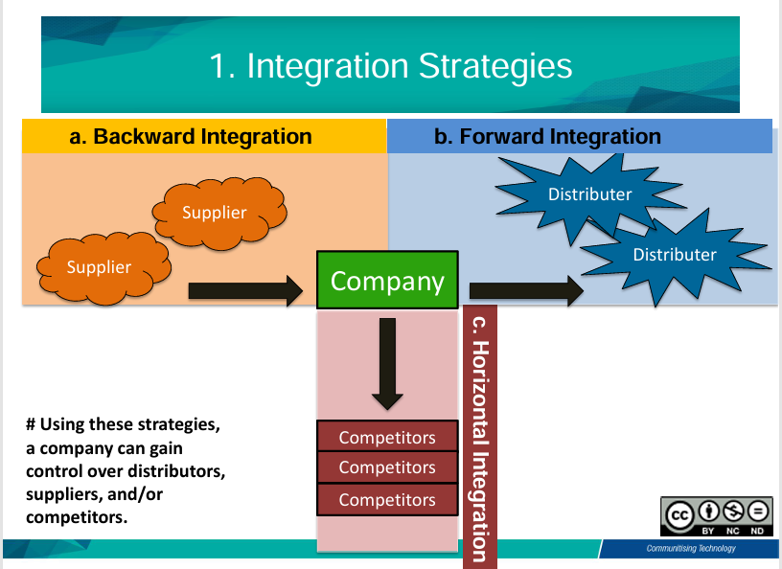

Slide 9
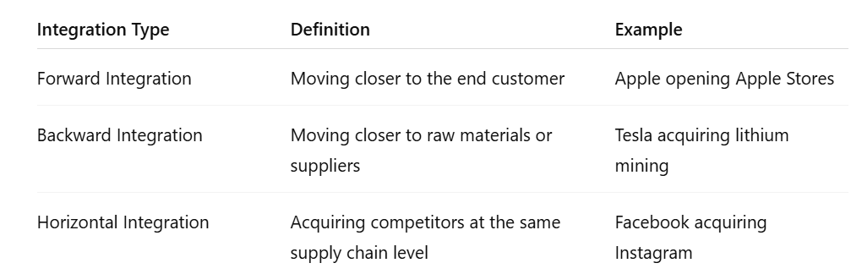

Slide 10
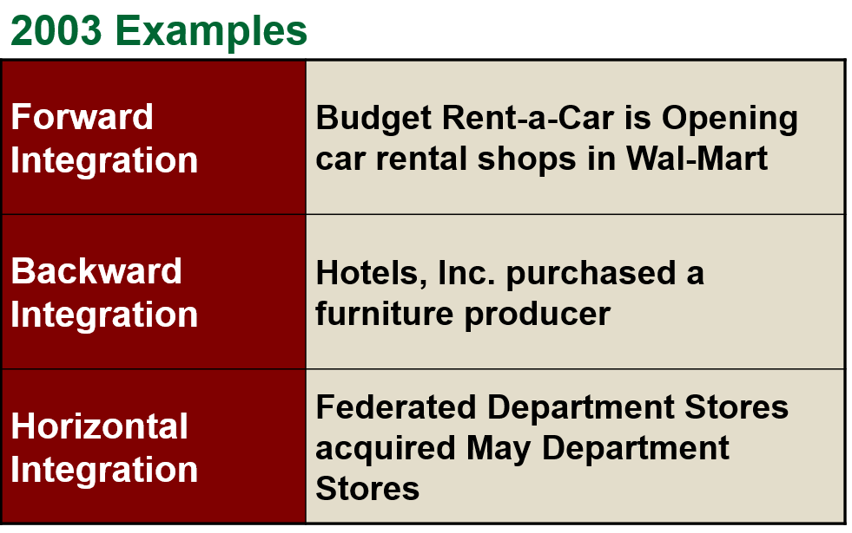
1. Forward Integration
This is when a company moves downstream in the supply chain—closer to the customer.
Apple: Originally a hardware and software manufacturer, Apple pursued forward integration by opening Apple Stores to sell its products directly to consumers, bypassing third-party retailers.
Coca-Cola: Buying bottling and distribution operations (e.g., Coca-Cola Enterprises) to control the delivery of its products.
2. Backward Integration
This is when a company moves upstream in the supply chain—closer to raw materials or production.
Tesla: Acquired lithium mining rights and battery manufacturing capabilities to control its EV battery supply chain.
Starbucks: Purchased coffee farms to gain more control over coffee bean sourcing and ensure quality.
3. Horizontal Integration
This is when a company expands by acquiring or merging with a competitor in the same industry and at the same stage of production.
Example:
Facebook (Meta): Acquired Instagram and WhatsApp—both in the social media and communication space—to consolidate its dominance.
Disney: Acquired 21st Century Fox, which was a competing entertainment and media company.

Slide 11
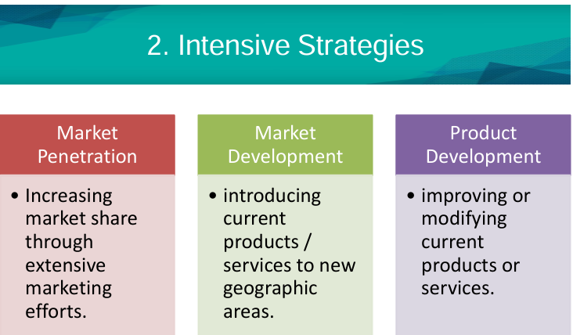

Slide 12
Intensive strategies are growth strategies that companies use to grow faster and increase market share by focusing on their current products and markets. There are three main types:
Market Penetration – Selling more of the current product in the existing market.
Example: Netflix offering aggressive promotions and improving user experience to get more subscribers in markets where it already operates.
2. Market Development – Entering new markets with the existing product.
Example: Starbucks expanding into new countries (like China or India) to sell its existing coffee products.
3. Product Development – Creating new products for the existing market.
Example: Apple launching new versions of the iPhone or entirely new products like the Apple Watch to sell to its existing customers.

Slide 13
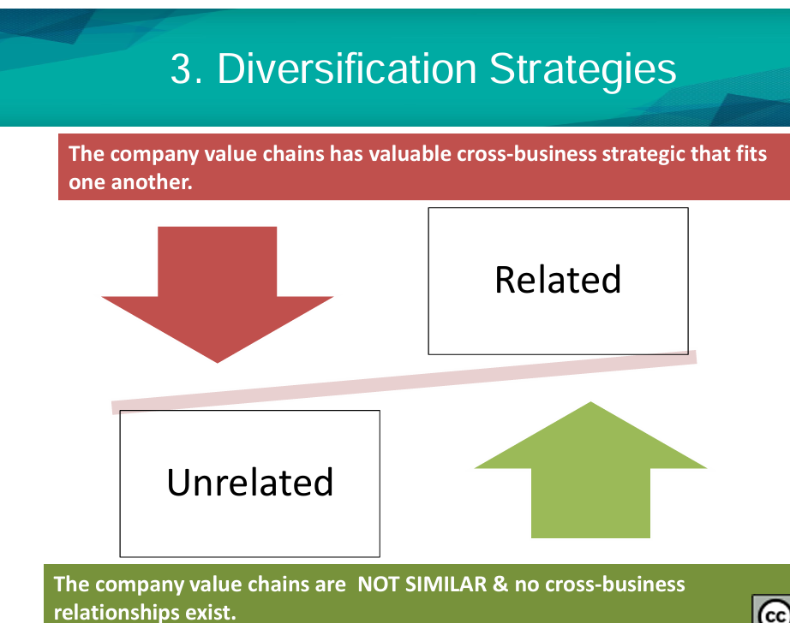

Slide 14
Related Diversification – Expanding into a new business that is related to the existing business.
Example-1 : Google (Alphabet Inc.) : Started as a search engine → then diversified into cloud computing, smartphones (Pixel), AI (DeepMind), and self-driving tech (Waymo). All these are tech-related, using similar capabilities or data infrastructure.
Example-2 : Disney
Originally a film company → expanded into theme parks, TV channels (like ABC), and streaming services (Disney+). All are entertainment-related, leveraging content and characters.
Unrelated Diversification – Expanding into an entirely different industry with no direct connection.
Example-1 : Tata Group (India): Operates in industries like steel, automobiles (Tata Motors), IT (TCS), hotels (Taj), and tea (Tata Tea).
These businesses are not directly connected—this is classic unrelated diversification.
Example 2: Samsung
Apart from electronics, Samsung has businesses in shipbuilding, construction, and insurance—entirely different industries.

Slide 15
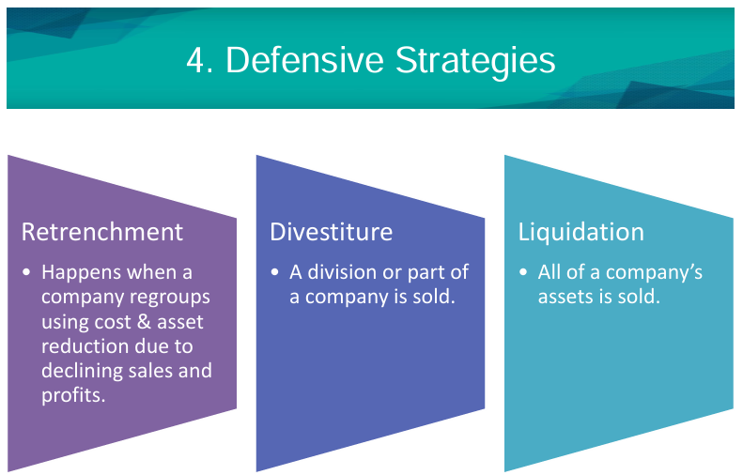
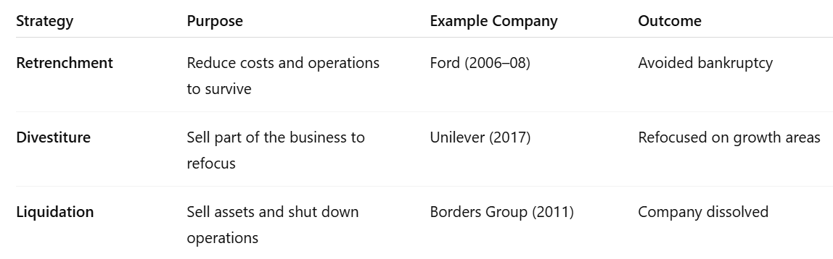

Slide 16
Divestiture Strategy
Divestiture refers to selling off a part of a company (a business unit, asset, or subsidiary) to improve focus, raise capital, or prevent financial collapse.
Divestment
GE was under pressure from declining profits and market share.
Strategy: GE divested from non-core businesses (e.g., GE Capital) to refocus on high-growth areas like aviation and renewable energy.
Outcome: GE stabilized operations and avoided total collapse.
Lesson: Shrinking to grow can be a defensive move to refocus on strengths.
🏢 Case 1: IBM Sells PC Business to Lenovo (2005)
Context: IBM was struggling in the low-margin personal computer market.
Strategy: IBM divested its PC division to Lenovo for $1.75 billion to shift focus to high-margin services and enterprise computing.
Outcome: IBM strengthened its position in software and consulting. Lenovo became a top global PC brand.
Lesson: Strategic divestiture helped IBM escape a commoditized market and invest in growth areas.

Slide 17
Liquidation Strategy Cases
Liquidation involves shutting down and selling off a company’s assets, usually when it’s no longer viable.
: Kingfisher Airlines (India, 2012)
Context: Mounting debts, rising fuel costs, and operational losses plagued the airline.
Strategy: After failed bailout talks, the airline ceased operations and went into liquidation.
Outcome: Its license was revoked; assets were auctioned to pay creditors.
Lesson: High fixed costs and regulatory pressure make airlines especially vulnerable to liquidation.

Slide 18
1. Retrenchment Strategy Case
🏭 Case: Ford Motor Company (2006–2008)
Context: Ford was facing falling sales, rising costs, and competitive pressure from Japanese automakers.
Strategy:
  Implemented the "Way Forward" plan
  Closed several plants
  Laid off over 30,000 employees
  Focused on core models (e.g. Ford, not Mercury or Jaguar)
Outcome: Streamlined operations, reduced costs, and improved efficiency. Ford avoided bankruptcy during the 2008–2009 financial crisis, unlike GM and Chrysler.
Lesson: Retrenchment can help companies weather financial storms by cutting excess fat and focusing on core competencies.

Slide 19
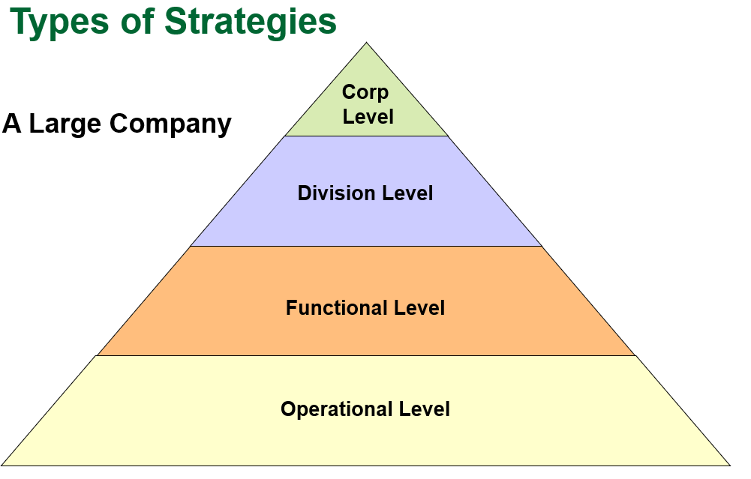

Slide 20
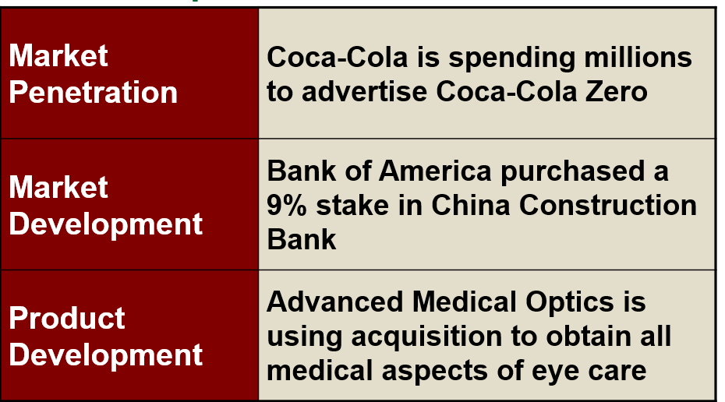

Slide 21
Strategic Implications
Retrenchment can offer quicker cost savings but raise legal and reputational risks—especially in India, where labor laws guarded layoffs/retrenchments during lockdowns.
Divestiture proved more measured, enabling firms to exit non-core lines, regain liquidity, and reallocate toward growth areas.
Liquidation was unavoidable for some, especially in retail/entertainment sectors hit hardest by COVID‑19 closures.

Slide 22
2003 Examples
Related Diversification | UPS acquired Overnite to diversify its packaging business into the trucking business
Unrelated Diversification | Tupperware Corp. has entered and is growing its skin and Beauty business through BeautiControl
Retrenchment | Viacom is selling non-core assets

Slide 23
2003 Examples
Divestiture | Goodyear Tire & Rubber Co. sold its North American farm-tire business to Titan International
Liquidation | Britain’s last major car manufacturer, MG Rover Group Ltd., liquidated in 2005 and laid off its 5,000 employees

Slide 24
Michael Porter’s Generic Strategies
Cost Leadership Strategies
(Low-Cost & Best-Value)
Differentiation Strategies
Focus Strategies
(Low-Cost Focus &
Best-Value Focus)

Slide 25
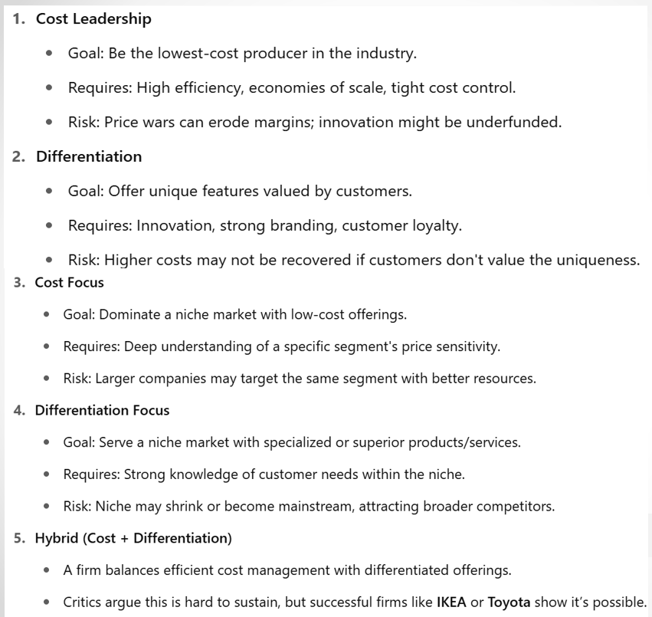

Slide 26
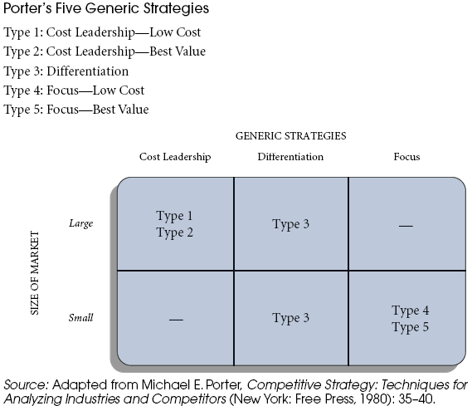

Slide 27
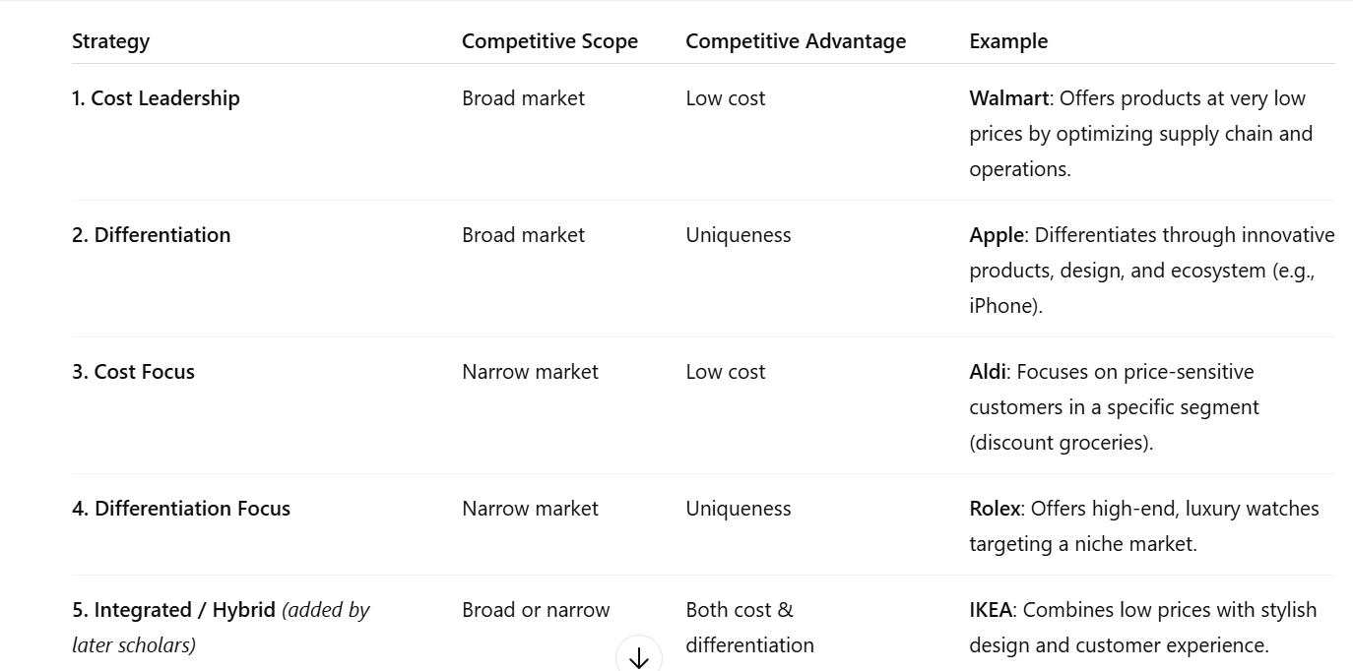

Slide 28
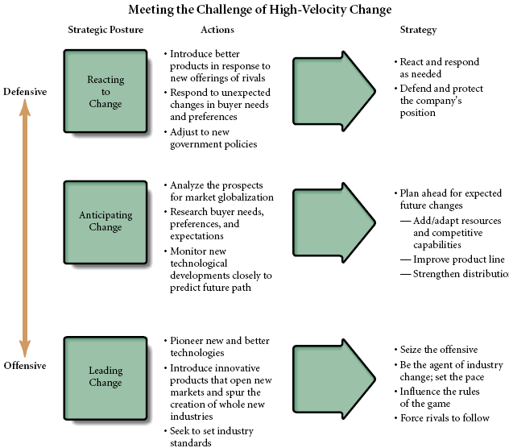

Slide 29
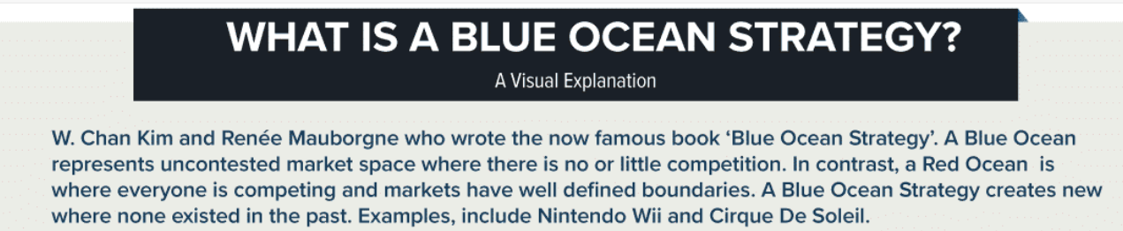
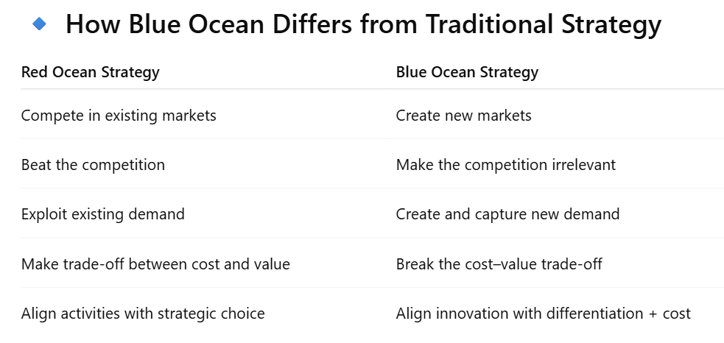
Blue Ocean Strategy is a business approach that encourages companies to create new market space ("blue oceans") rather than competing in existing saturated industries ("red oceans").

Slide 30
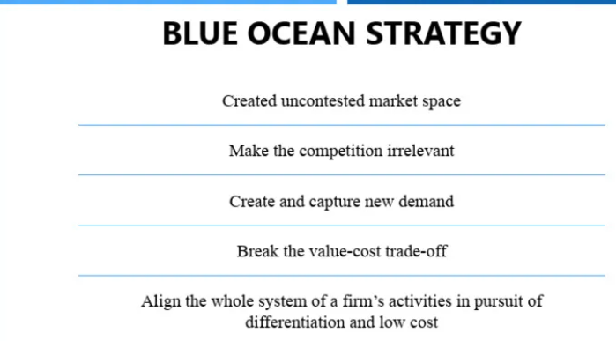
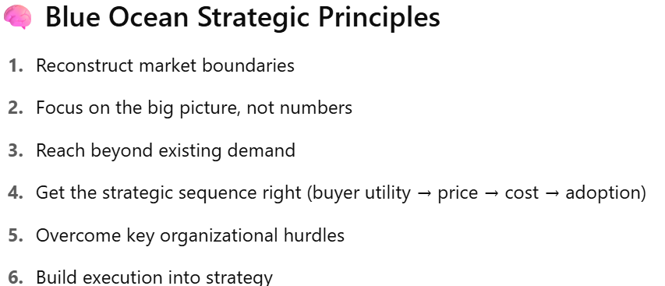

Slide 31
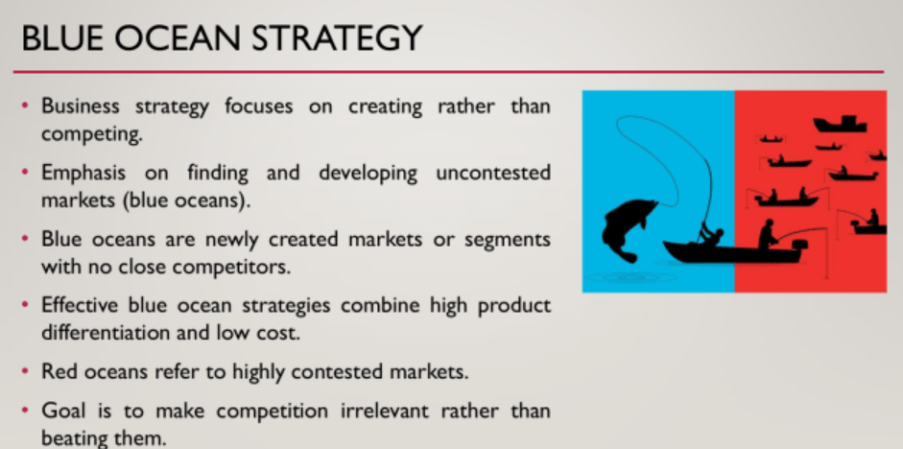

Slide 32
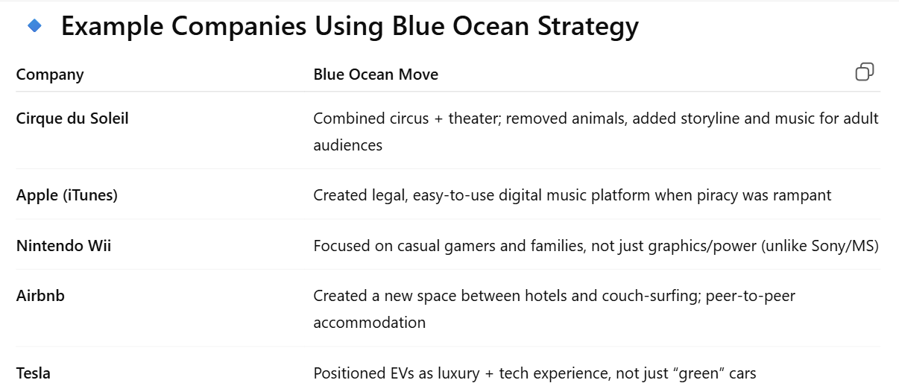

Slide 33
